Slide 1
Sorting Visualizer
Hackathon-Hack The Mountains 2.0
Made by – Sneha M

Slide 2
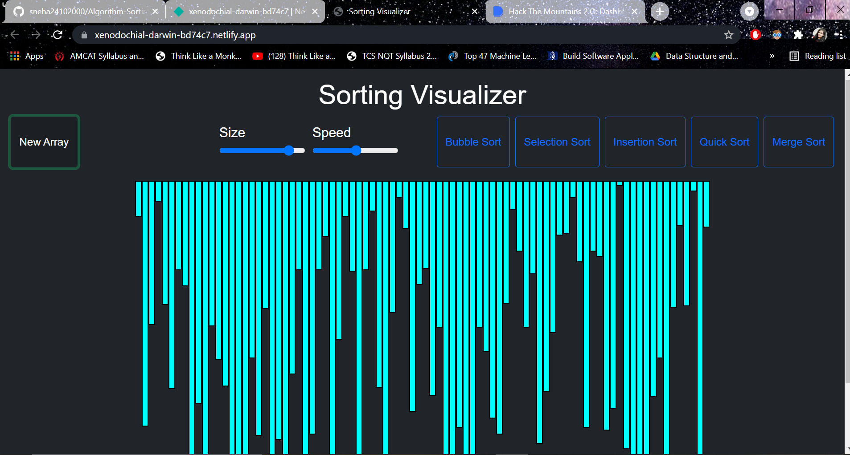

Slide 3
I built a Sorting visualizer to visualize and understand the sorting algorithms. As of now, I built only 5 sorting algorithms as - -Bubble sort -Selection sort -Insertion sort -Merge sort -Quicksort

Slide 4
FrameWorks Used-
HTML
CSS
JAVASCRIPT
This project sorting visualizer is a very simple UI which allows the users to select the sort algorithm, select the array size, and speed of the visualization.

Slide 5
Pre-requisites
1. Code editor (which you prefer) I prefer VSCode
2. HTML
3. CSS
4. JS

Slide 6
Challenged I Faced-
Site responsiveness-As a beginner , bringing site responsiveness was a challenge as I have to learn CSS from scratch.
Writing sort algorithms in JS- The second challenge I faced writing sort algorithms in JS. As I am a C/C++ Coder I used to write codes and algorithms in these two languages only so I took more time to implement the all the sorting algorithms.

Slide 7
Future Enhancement’s in this project-
Currently available sorting algorithms- Bubble sort, Selection sort, Insertion sort, Merge sort, Quicksort (I will plan to bring more algorithms in action to visualize & more changes).
You can change the size of the array.
You can change the speed of the visualization.
Link to Project –
https://xenodochial-darwin-bd74c7.netlify.app/

Slide 8
Conclusion
This was my first project which I was deploying the website live.Thanks to MLH to conduct “Hack The Mountains 2.0” Hackathon which helped me to showcase my skills.
This was a great learning experience for me creating a full application from scratch.

